Slide 1
Tools for Geochemical Analysis Dr. Anoop Ambili

Slide 2
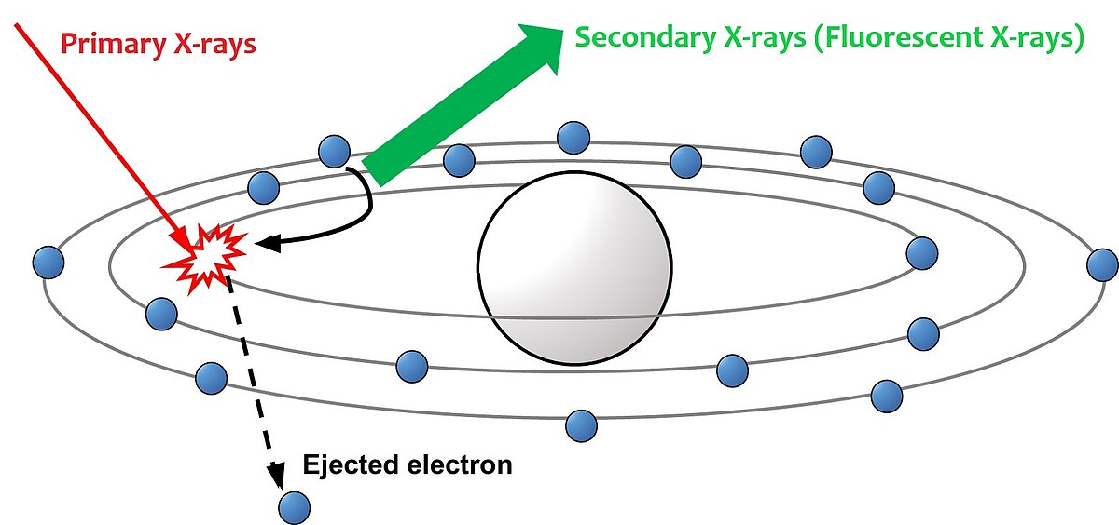
X ray fluorescence technique

Slide 3
Introduction
➢ICP-MS – most widely used techniques for the rapid multi elements quantification at the ultra trace level (ppt range) – at the same time can quantify at the ppm level
➢1983: First commercialized by Perkin Elmer - fastest growing trace element technique
➢Originally developed for trace element quantification in liquid sample – modern instrumentation is capable of analyzing solid sample directly (LA-ICP-MS) – capable of measuring isotope ratio
➢Diverse application fields: Environmental, Geological, Semiconductor, Biomedical, Nuclear Application, drugs and pharmaceuticals etc.
(Lit.: Thomas R. 2013_Chapter 1; Gill, 1997_Chapter 10)

Slide 4
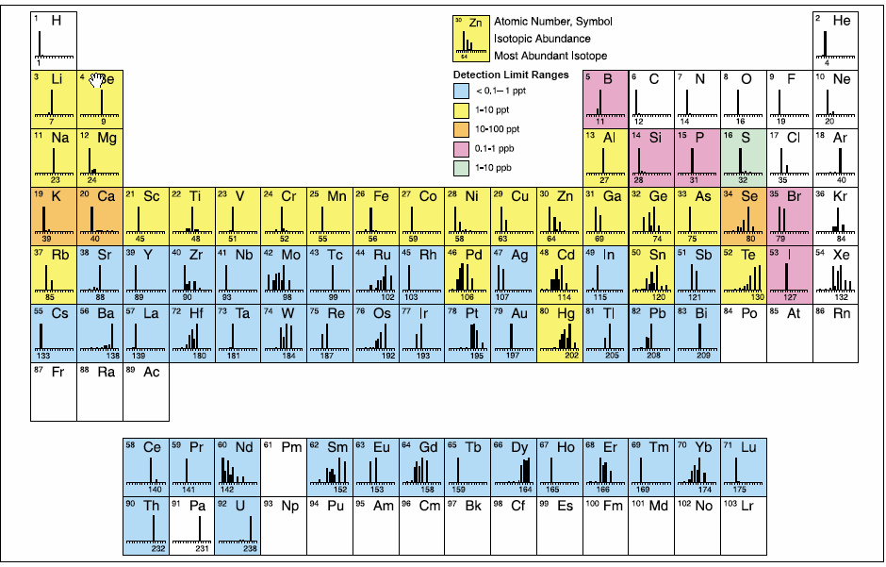
Elements analysed using ICP-MS

Slide 5
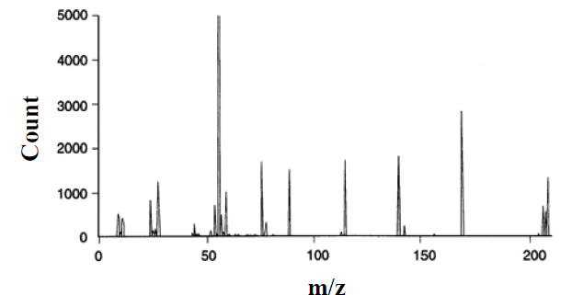
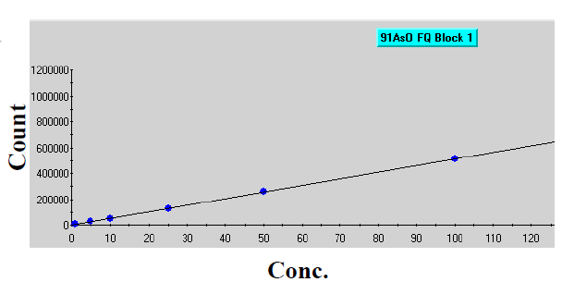
Working Principle
Uses mass spectrometry – separation of ions (coming from plasma source) according to their mass/charge ratio (m/z)
Sample
Source of ionization
Ion selection based on m/z
Detector
Notes:
https://youtu.be/tP5ZKUTWiuQ?si=K1RwNbPQPr2_qFsq

Slide 6
Instrumentation
i) Nebulizer v) Vaccuum chamber
ii) Spray chamber vi) Ion optics
iii) ICP torch vii) Mass separation device
iv) Interface cones viii) Ion detector
(Lit.: Thomas R. 2013_Chapter 1)
Notes:
https://youtu.be/tP5ZKUTWiuQ?si=K1RwNbPQPr2_qFsq

Slide 7
Basic instrument component function

Slide 8
ICP-MS Samples Introduction area

Slide 9
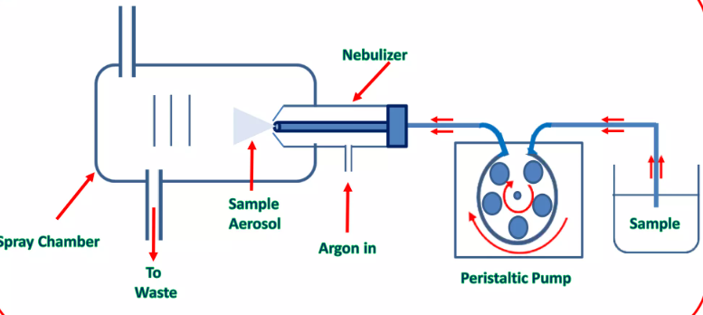
Peristaltic Pump
Ensures constant flow of liquid irrespective of differences in viscosity between samples, standards and blanks. Sample pumped at 1ml/min
Nebulizer
Sample aerosol
Sample
Spray chamber
Sa
Argon in
To waste
Peristatic Pump

Slide 10
Micromist Nebulizer:
Liquid is converted into a fine aerosol by pneumatic action of a flow of argon gas (~1L/min) smashing the liquid into tiny droplets.

Slide 11
Double Pass Spray Chamber:
Spray Chamber only allows small droplets (<10μm) to enter the plasma. Larger droplets having higher momentum collide with wall of spray chamber, get condensed & eventually fall out by gravity through the drain

Slide 12
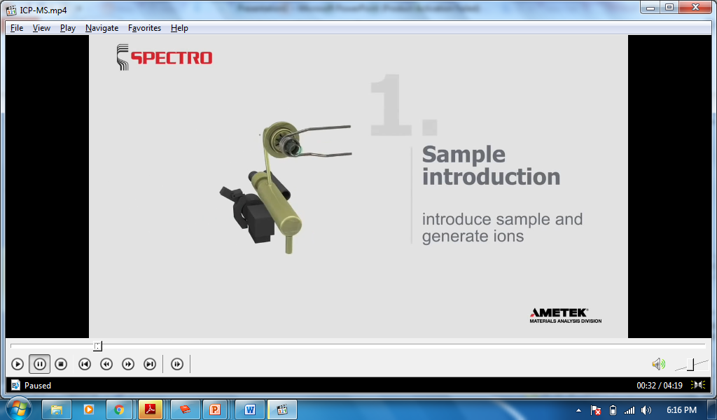
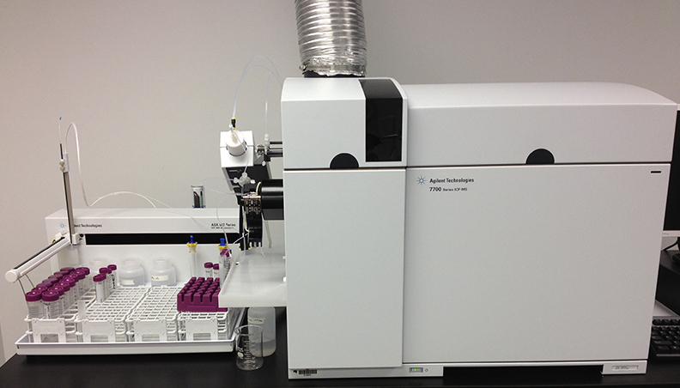
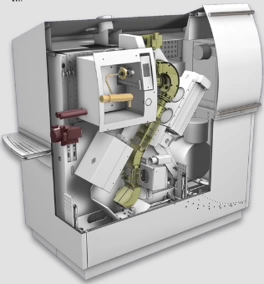
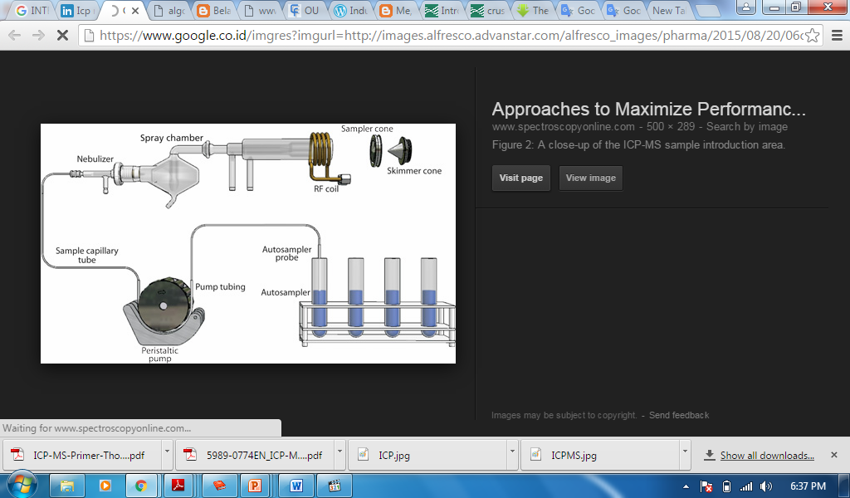

Slide 13
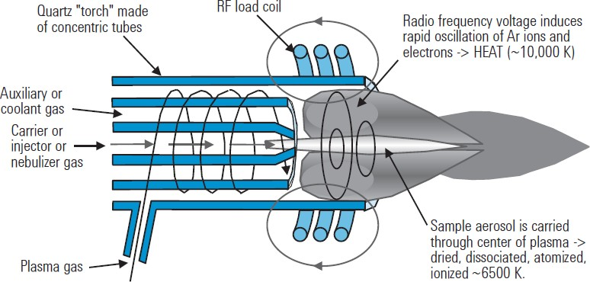

ICP Plasma Ionization Source
Inductively coupled plasmas are formed by coupling energy produced by a RF generator to the plasma support gas with an electromagnetic field. The field is produced by applying an RF power (typically 700-1500 W) to a load coil.

Slide 14
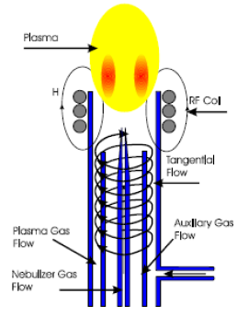
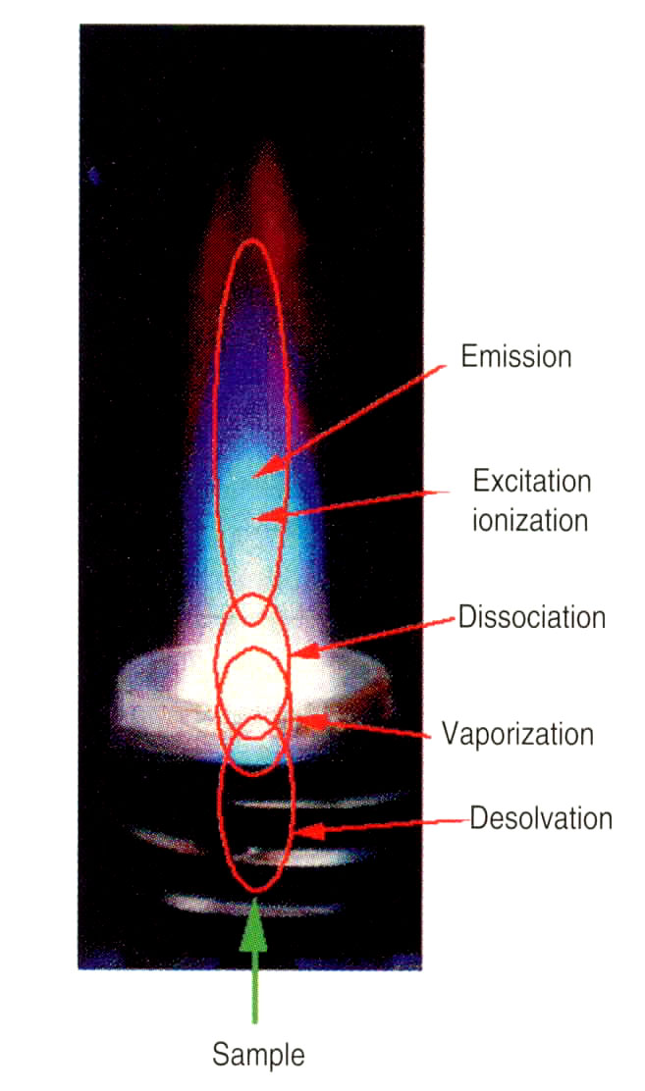
Ionization Process
RF generator is a tool that provides a voltage (700-1500 watts) to ignite the plasma with Argon gas as its source.
This voltage is transferred to the plasma through a load coil, which surrounds the peak of the Torch.
When the sample gas into the plasma occurs excitation of atoms occurs.

Slide 15
Typical ionization for elements
Element | First Ionization Potential (eV) | Ionization Efficiency in ICP | Degree of Ionization
Aluminum (Al) | 5.98 eV | High | >90%
Calcium (Ca) | 6.11 eV | High | >90%
Iron (Fe) | 7.87 eV | High | >90%
Magnesium (Mg) | 7.64 eV | High | >90%
Sodium (Na) | 5.14 eV | Very High | >95%
Copper (Cu) | 7.72 eV | High | >90%
Lead (Pb) | 7.42 eV | High | >90%
Zinc (Zn) | 9.39 eV | High | >80%
Arsenic (As) | 9.79 eV | High | >80%
Bromine (Br) | 11.81 eV | Moderate to High | 50–90%
Mercury (Hg) | 10.44 eV | Moderate | 50–70%
Gold (Au) | 9.22 eV | Moderate | 50–70%
Uranium (U) | 6.1 eV | High | >90%
Platinum (Pt) | 8.96 eV | Moderate | 50–70%
Barium (Ba) | 5.21 eV | High | >90%
Tungsten (W) | 7.98 eV | Moderate | 60–80%
Chlorine (Cl) | 12.97 eV | Moderate | 50–70%
Silver (Ag) | 7.57 eV | High | >90%
Argon first ionization potential ~ 15 eV

Slide 16
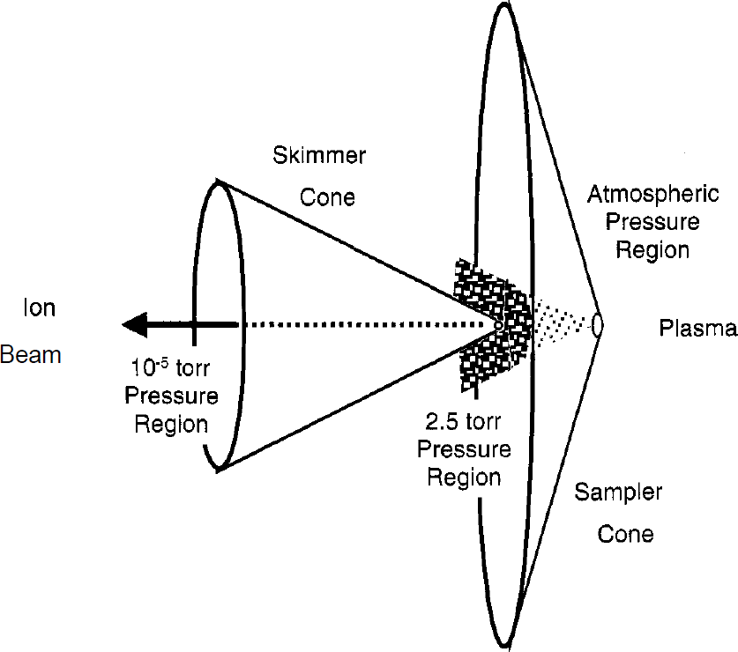
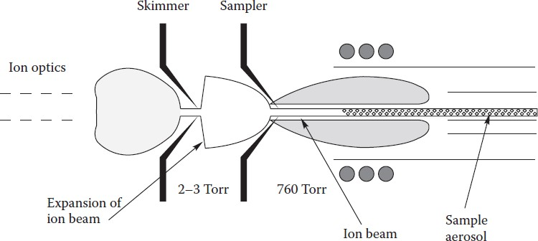
ICP Interface Region
A section that connects the ionizing section at ambient pressure to the mass spectrometer at high vacuum(~10⁻⁶ torr).
Function is to export the ions produced in argon plasma and transport them to the mass spectrometer
Two metallic (Ni or Pt) cones with small orifices (1mm)- Sampler and Skimmer Cones directs the expanded gas jet of ions into the MS

Slide 17
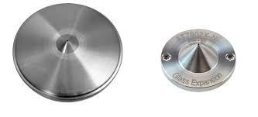
Interface
Sampling Cone (1mm dia)
Skimmer Cone (0.45 mm dia)

Slide 18
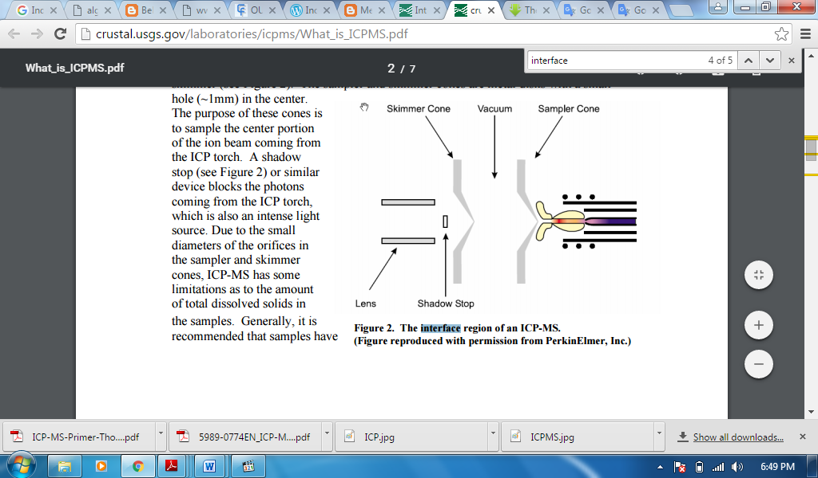
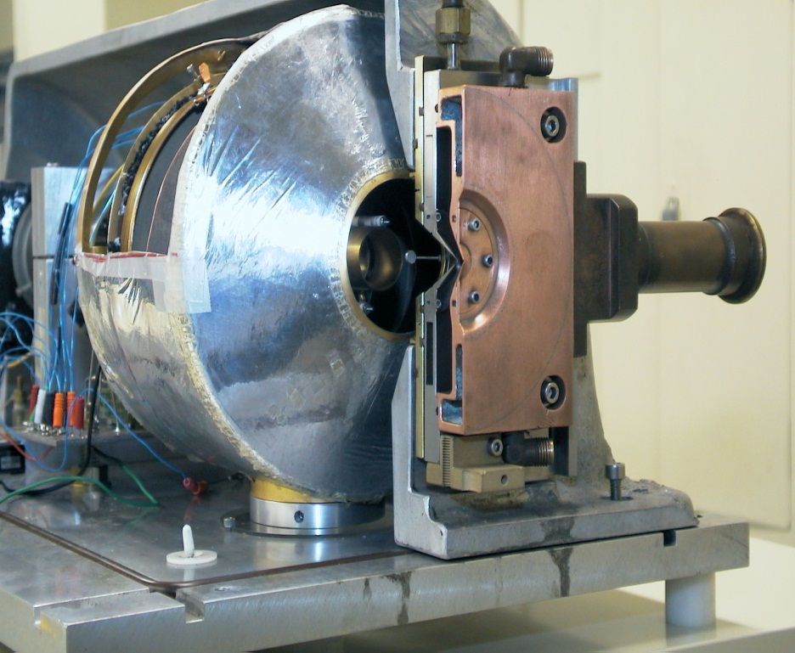
INTERFACE
Interface serves to direct the ions toward the mass spectroscopy.
Interface area consists of two conical metal (usually nickel) called sampler cone and skimmer cone, each with small holes to allow ions to pass through to the ion optics

Slide 19
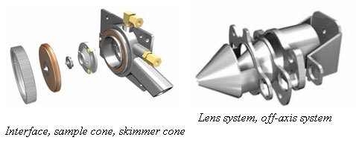
Ion Lenses
Prevent Neutron and photon to enter
Reduce interferences

Slide 20
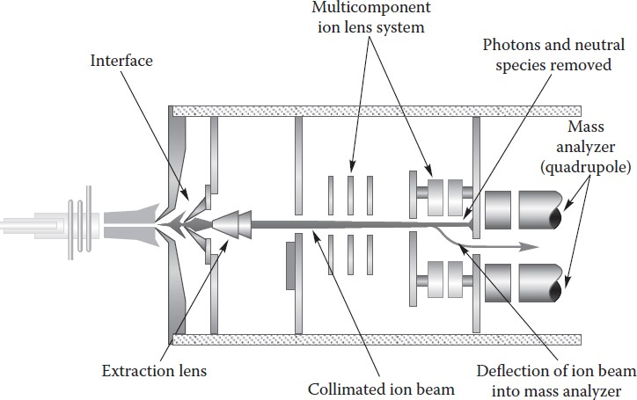
ICP Ion Focussing Region
One or more electrostatically controlled lens component made up of series of metallic plates or cylinders having a voltage placed on them
Ions are separated from Photons & Neutrals by positioning MS off-axis to the ion beam or using a Physical barrier
Role of ion focussing is to transport maximum number of analyte ions
from the hostile environment of plasma to the MS via the interface.
Photons & Neutrals cause signal instability & contribute to
background noise.
Voltages on the ions lens components electrostatically steer the ions of
interest into the MS.

Slide 21
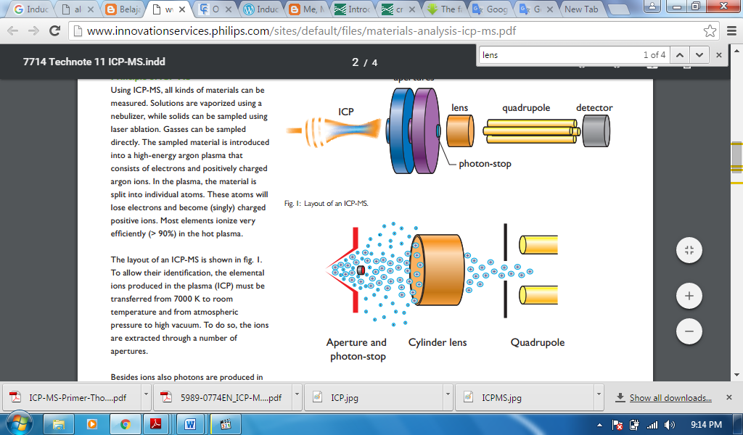
Ion Focusing
Delivers ions toward the Quadrupole
Stop or hinder the electrons, protons and neutrons to the detector analyzer

Slide 22
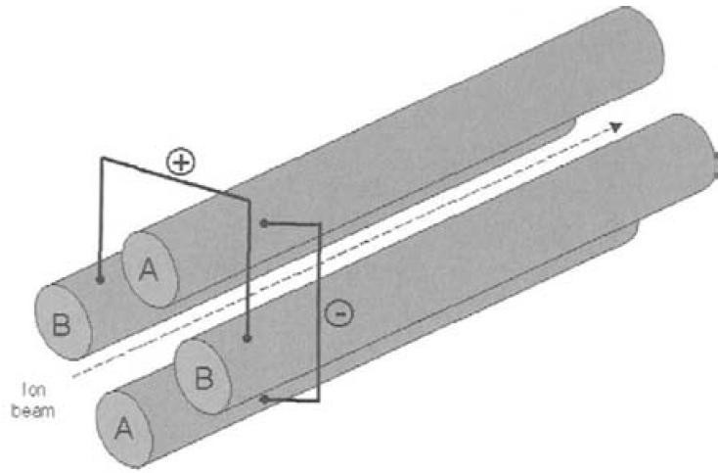
Mass Analyzer- Quadrupole
Made of stainless steel or molybdenum with ceramic coating, 15-25 cm in length, 1cm in diameter
Scanning mode and selective mode
Quadrupole is a sequential mass filter, which separates ions based on their m/z.
Two pairs of parallel cylindrical rods to which a varying AC voltage plus a DC voltage is applied.
Any ion above or below the set mass of the quadrupole enters an unstable trajectory and gets lost from the ion beam.
Measurement of the m/z of the ion allows qualitative identification of the isotope or molecule. Magnitude of the ion current is used to provide quantitation of the amount of the analyte in the original sample

Slide 23
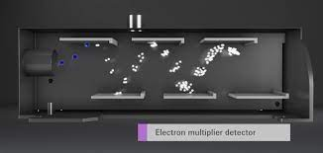
Detector
Electron Multiplier

Slide 24
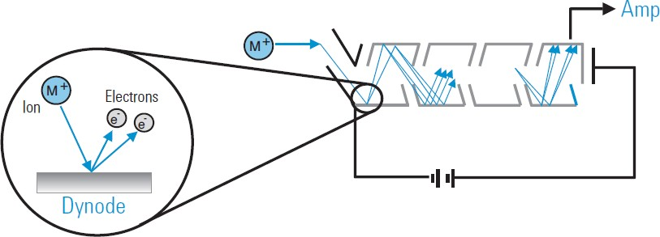
Ion Detectors
Detector is an Electron Multiplier Device which can generate a measurable signal pulse from the impact of a single ion.
A positive ion arrives at the mouth of the detector, it is deflected onto the first dynode, held at a high negative voltage.
The impact of the ion releases several free electrons from the dynode surface, which are repelled from the high negative voltage at the front and strike the next dynode.
Each electron which strikes a dynode releases several electrons from that surface and hence the device is called "electron multiplier". The multiplication factor builds up a pulse large enough to be measured reliably as an ion "count".

Slide 25
Spectral Interferences – I
Probably most serious type of interferences observed in ICP-MS
Polyatomic or molecular spectral interferences: produced by the combination of two or more atomic ions derived from the
Plasma / nebulizer gas (e.g. ⁴⁰Ar⁺ vs ⁴⁰Ca⁺; ⁴⁰Ar¹⁶O⁺ vs ⁵⁶Fe⁺; ⁴⁰Ar⁴⁰Ar⁺ vs ⁸⁰Se⁺; ³⁸Ar¹H⁺ vs ³⁹K⁺; etc.)
Matrix components in the sample (e.g. ⁴⁰Ar²³Na⁺ vs ⁶³Cu⁺; etc. )
Solvent or acid used in the sample preparation (e.g. ⁴⁰Ar¹²C⁺ vs ⁵²Cr⁺; ⁴⁰Ar³⁵Cl⁺ vs ⁷⁵As⁺; ³⁵Cl¹⁶O+ vs ⁵¹V⁺; ⁴⁰Ar¹⁵N⁺ vs ⁵⁵Mn⁺; ³²S¹⁶O¹⁶O⁺ vs ⁶⁴Zn⁺; etc.)
Entrained oxygen and nitrogen from the surrounding air

Slide 26
Spectral Interferences – II
Hydrides, oxides, hydroxides species:
Produced by the combination of elements present in the sample with 1H+, 16O+ or 17OH+ (either from water or air), occur at 1, 16, and 17 mass units respectively higher then the element mass
Typically produced in the cooler zone of the plasma, immediately before the interface region
If rare earth or refractory-type elements are present in the sample, they readily form molecular species (especially oxides)
Doubly charged species:
When an ion is generated with a double positive charge, instead of normal single charge – produces an peak at half of its mass
Doubly charged species formation is influenced by ionization condition in the plasma – secondary discharge at the interface enhances doubly charged species formation

Slide 27
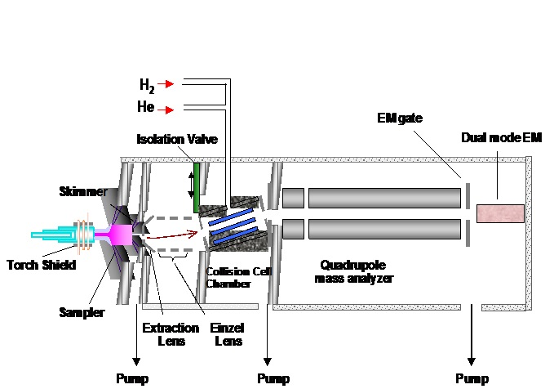
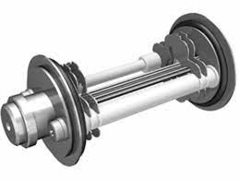
Collision Reaction Cell
Octopole ion guide, positioned between ion lens assembly and quadruple mass filter.
Helps in reduction of spectral interferences.

Slide 28
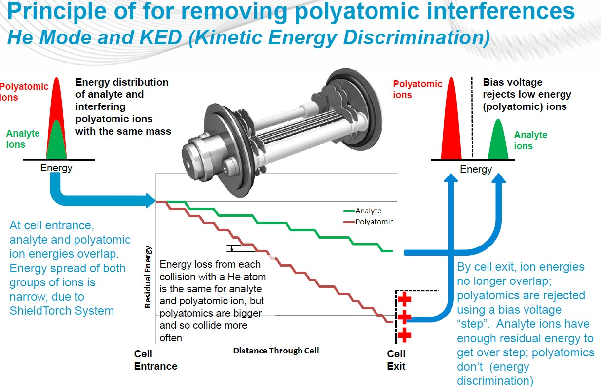
Collision Mode:

Slide 29
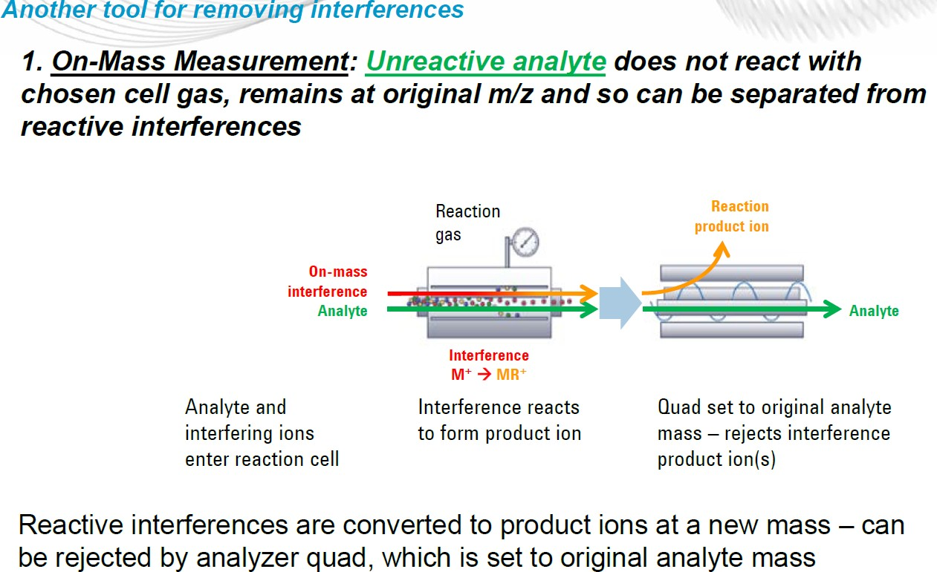
Reaction Mode:
⁴⁰Ar ³⁵Cl⁺ +H₂ → HCl+ Ar⁺

Slide 30
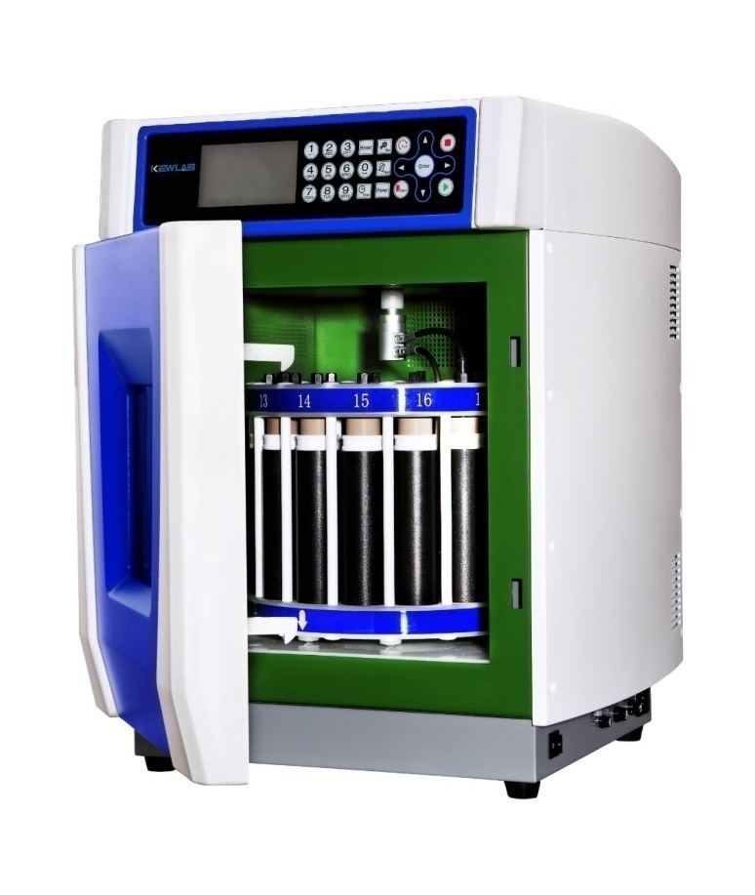
Sample Preparation
Biological/rock samples are usually diluted or thermally digested before analysis.
Common diluents include dilute acids (e.g. nitric acid, hydrochloric acid) or alkali (e.g. ammonium hydroxide, tetramethylammonium hydroxide)
Solid samples such as rocks, tissue, hair and nails require chemical digestion to dissolve the sample before analysis.
The digestion can be carried out using strong acid(s) or alkali, either at room temperature or heated in a hot water bath, dry heating block or high-pressure microwave to assist digestion.

Slide 31
Internal Stadardization
Employed to correct for changes in instrument operating conditions and sample specific matrix effects which may enhance or suppress the analyte signal.
Same quantity of “internal standard” is added to each sample, standard and blank.

Slide 32
Contamination issues
Various factors influence the ability to get the correct result with any trace element technique. Potential Sources of contamination must be addressed

Slide 33
Methods of Quantification
Quantitative analysis in ICP-MS is the fundamental tool used to determine analyte concentrations in unknown samples.
The instrument is calibrated by measuring the intensity for all elements of interest in a number of known calibration standards that represent a range of concentrations likely to be encountered in your unknown samples.
Software creates a calibration curve of the measured intensity versus concentration for each element in the standard solutions
Once calibration data are acquired, the unknown samples are analyzed by plotting the intensity of the elements of interest against the respective calibration curves. The software then calculates the concentrations for the analytes in the unknown samples.
This type of calibration is often called external standardization and is usually used when there is very little difference between the matrix components in the standards and the samples

Slide 34
ICP-MS application
Environmental
Drinking water, ambient water
Soils, Sludge, Solid waste
Plant material/Agriculture
Speciation of Hg, As, Pb and Sn
Clinical
Blood, Urine, Serum
Hairs, Tissues
Toxicology
Nutrition/deficiency/ vitamins
Food analysis
Nutrition
Toxic element and species monitoring
QA/QS
Pharmaceutical
Routine heavy metal contamination
Drug discovery
Clinical trials
Nuclear
Fuel production
Measurement of radioisotopes
Primary cooling water
Geological
Soil, Rock, Sediment
Hydrology
Isotope ratio studies
Archaeological
Artifact analysis, proof of origin
Tooth, bone, tusk, shell, coral analysis
Forensics
Gun shot residue
Material characterization
Point of origin
Poisoning

